Slide 1
Socialize with others
Welcome!
Group meeting 9

Slide 2
Today´s planning
Part 1
Focus exercise Being here & now
Review of homework
Break
Part 2
About socializing with others
New homework
Summary of the group meeting
Group meeting 9
Socialize with others

Slide 3

Socialize with others
When we socialize with others, we can experience stressful thoughts, emotions, and bodily reactions
Common with evaluative and comparative thoughts
Examples: 'There is something wrong with me,' 'Others are better at socializing than me’
Evaluative and comparative thoughts make us stressed
Focus training, perspective, acceptance, and life values can help manage stress in social situations
’There's something wrong with me’
Group meeting 9
Socialize with others

Slide 4
Socialize with others
We can have evaluative thoughts about others
Example: 'She has an ugly hairstyle’
Own examples of evaluative and comparative thoughts in social situations?
Examples of how to handle these thoughts?
’She has an ugly hairstyle’
Group meeting 9
Socialize with others

Slide 5
Socialize with others
The thoughts evoke emotions
Example: Irritation
Own examples of emotions in social situations?
Examples of how to handle the emotions?
Irritation
Group meeting 9
Socialize with others

Slide 6
Socialize with others
The thoughts evoke bodily reactions
Example: Tension
Own examples of bodily reactions in social situations?
Examples of how to handle the bodily reactions?
Tension
Group meeting 9
Socialize with others

Slide 7
Exercise 1: Describe yourself
Split up into pairs
Describe yourself for one minute in a neutral way (physical characteristics)
Notice if you have evaluative or comparative thoughts
Talk together in the group about your experiences during the exercise
Group meeting 9
Socialize with others

Slide 8
Exercise 2: Describe the other
Split up into pairs
Describe the person in front of you for one minute in a neutral way (physical characteristics)
Notice if you have evaluative or comparative thoughts
Talk together in the group about your experiences during the exercise
Group meeting 9
Socialize with others

Slide 9
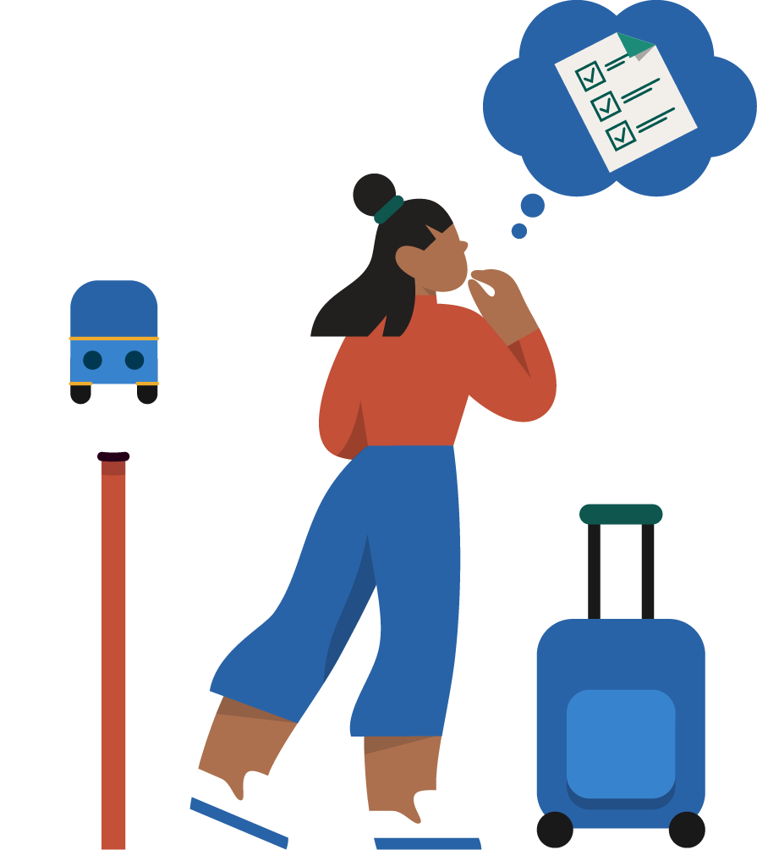
Homework
Do the Focus exercise 'Being Here & Now' five times
Write down two social situations that you want to manage in the homework sheet
Do one goal behavior in a social situation
Use Focus training, perspective, acceptance, and life values to handle stressful thoughts, emotions, and bodily reactions in the social situation
Fill in weekly planner 9
Group meeting 9
Socialize with others

Slide 10
Thank you for today and good luck!
Group meeting 9

