Slide 1
Take perspective
Welcome!
Group meeting 4

Slide 2
Today´s planning
Part 1
Review of homework
Break
Part 2
About perspective-taking
New homework
Summary of the group meeting
Group meeting 4
Take perspective

Slide 3


’I can't handle it’
’I need to get out of here’
’It's no use’
Group meeting 4
Take perspective

Slide 4

Step 5. Do one thing at a time
Be focused on what's happening right now
Allow thoughts to come and go without getting caught in them
Group meeting 4
Take perspective

Slide 5

’I can't handle it’
’I need to get out of here’
’It's no use’
I focus on the conversation in the group and let thoughts come and go
Group meeting 4
Take perspective

Slide 6

Step 6. Doing what I want
Do what you want without letting thoughts get in the way
Group meeting 4
Take perspective

Slide 7
’I can't handle it’
’I need to get out of here’
’It's no use’
I attentively listen without letting thoughts disturb me
Group meeting 4
Take perspective

Slide 8
Exercise 1
Stand up from the chair
You are sitting on a chair
As you stand up from the chair, you say to yourself: 'I can't stand up from the chair’
Talk together in the group about thoughts, feelings, and bodily reactions that you experienced during the exercise
Group meeting 4
Take perspective

Slide 9
Exercise 2
Use the worksheet My thoughts
Notice if you have evaluative or comparative thoughts during the exercise
Talk together in the group about thoughts, feelings, and physical reactions that you had during the exercise
Group meeting 4
Take perspective

Slide 10
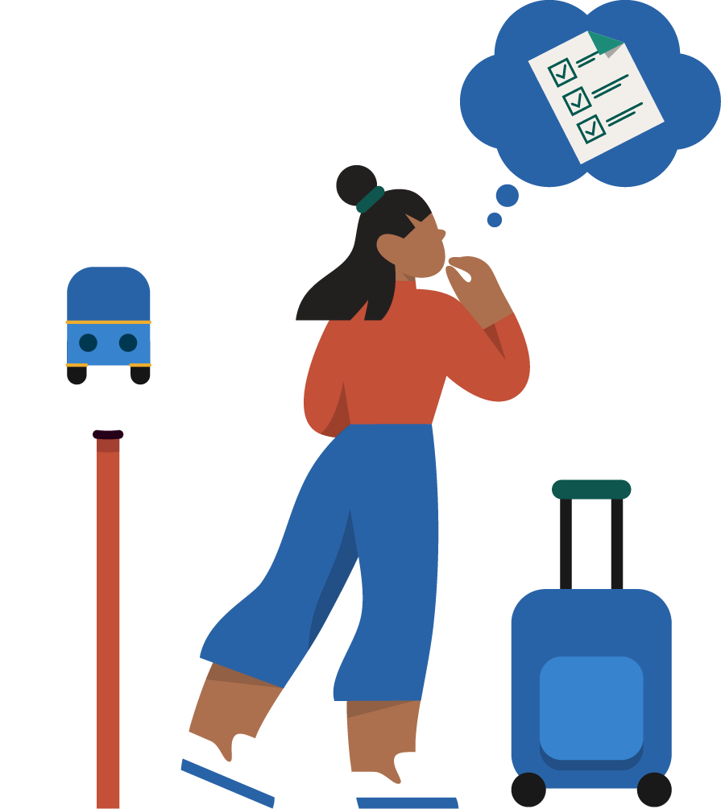
Homework
Do Focus exercise 4 Changing focus five times
Fill in homework sheet 4 (My thoughts)
Fill in weekly planner 4
Group meeting 4
Take perspective

Slide 11
Thank you for today and good luck!
Group meeting 4

