Slide 1
My self-care
Welcome!
Group meeting 10

Slide 2
Today´s planning
Part 1
Focus exercise Being here & now
Review of homework
Break
Part 2
About self-care
New homework
Summary of the group meeting
Group meeting 10
My self-care

Slide 3
Stress
Stress for a short period is completly harmless
This allows us to gain energy and handle things
Example: Running to catch the bus
Long-term stress can be harmful to health
Can affect memory, concentration, and mood
Example: Working ten hours without a break, sitting at the computer all day without a break
More examples?
Group meeting 10
My self-care

Slide 4
Stress
Long-term stress can create mental ill-health
Exempel: Depression, anxiety, sleep problems, exhaustion
Personal experiences of prolonged stress?
Group meeting 10
My self-care

Slide 5
Self-care
Self-care is activities that reduce stress in the body
What is self-caring varies from person to person
Self-care isn't always the same as resting – it can be an activity
Examples: Listening to music, physical exercise, painting, playing games, watching cat videos on YouTube
Group meeting 10
My self-care

Slide 6
Self-care
Focus training, perspective, and acceptance can be helpful
Make the activity truly self-caring
Example: Listening to music while dealing with anxious thoughts, managing strong emotions while resting on the couch
Group meeting 10
My self-care

Slide 7
Exercise 1: My self-care
Use the worksheet My self-care
Write down what is self-caring for you
Talk together in the group about your self-caring activities
Group meeting 10
My self-care

Slide 8

Exercise 2: Something you like
Think about something you enjoy for a minute
Examples: A place, an object, or an activity that you enjoy and find restorative from stress
Notice thoughts, feelings, and bodily reactions
Talk together in the group about your experiences during the exercise
Group meeting 10
My self-care

Slide 9
Exercise 3: Energy scale
1
2
Energy scale – like a battery
Different self-caring activities depending on how much energy you have
Example 1: Lie on the couch if you have low energy
Example 2: Play a musical instrument if you have high energy
Talk together in the group about your experiences of low and high energy self-caring activities
3
4
5
6
7
8
9
10
Group meeting 10
My self-care

Slide 10
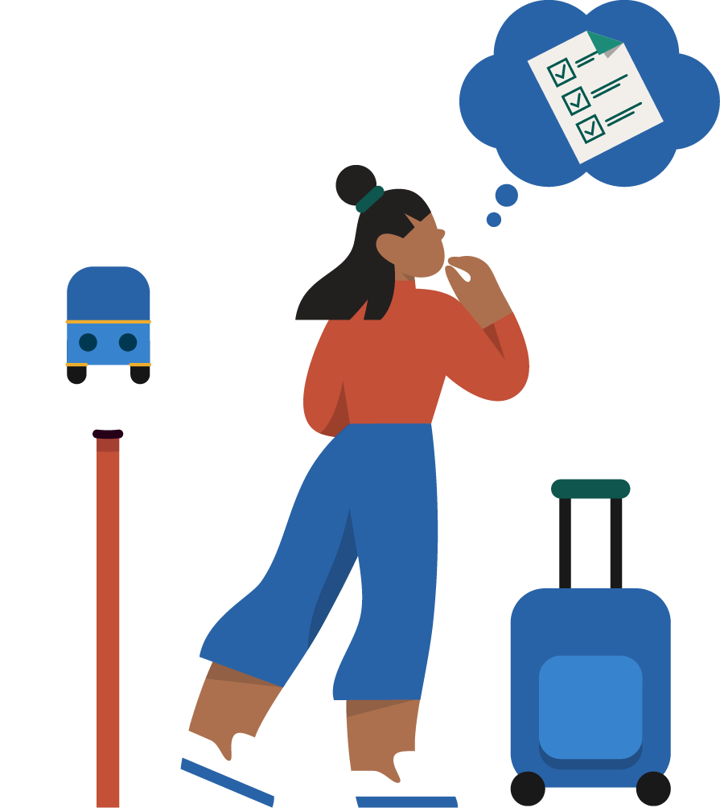
Homework
Do any Focus exercise five times
Write down two self-caring activities in the homework sheet
Do the self-caring activities during the week
Do one goal behavior in the life area Leisure
Use focus training, perspective, acceptance, and life values when you do the goal behavior
Fill in weekly planner 10
Group meeting 10
My self-care

Slide 11
Thank you for today and good luck!
Group meeting 10

